Slide 1
How to Strengthen
Children’s
Reading Comprehension Skills
by Reading Aloud to Them
Tips for parents

Slide 2
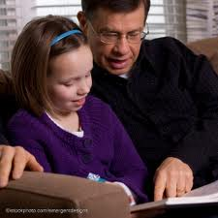
The single most important activity for building the knowledge required for eventual success in reading is…
Reading Aloud to Children.
from A Nation At Risk, 1983

Slide 3
Children Who Are Read to…
Develop a strong sense of story
Are used to thinking along with text
Create mental pictures more readily
Have longer attention spans
Develop the habits of readers

Slide 4
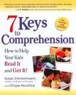
The Power of Reading Aloud to Your Children
Promotes a love of reading
Develops listening skills
Increases background knowledge and vocabulary
Provides opportunity to model reading comprehension strategies

Slide 5
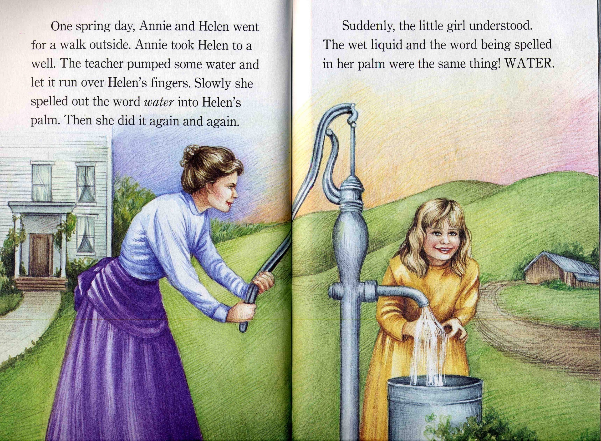
Reading biography builds background knowledge and cultural literacy.

Slide 6
“When we read, we carry on an internal conversation. We debate the evidence and evaluate what we’re reading. We determine if it makes sense with what we already know.
For children to read with understanding, they must develop these habits of mind.”
Richard Allington
Reading Researcher

Slide 7
Reading Comprehension Strategies
• Monitor understanding (Huh? Do I understand this? What’s going on?)
• Use fix up strategies (reread, read slower, read in chunks, read aloud)
• Visualize (or use a picture, diagram) “I can picture this in my mind…”
• Make connections, use benchmarks (This is like the time when…Dad is 6 feet tall…)

Slide 8
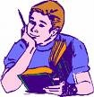
• Ask a question, wonder something (“Why is she doing that?” “What is the author trying to tell me?” “Who is that character?”)
• Draw a conclusion, make an inference, predict (“That must mean…” “What he did made me think he’s…” “I think the next thing that will happen is…”)
• Retell/paraphrase
• Focus on new vocabulary

Slide 9
Model “The Reader’s Job”
At the beginning of a book:
Note the names of the author and illustrator.
Look at the cover and read the book blurb. Tell your child what you think the book’s going to be about.
Figure out who’s telling the story (narrator) and where and when it takes place. (setting)
Identify the main characters.

Slide 10
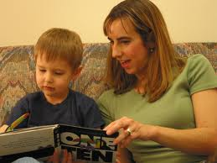
Think Aloud As You Read Fiction
Talk about what the words are making you picture in your mind.
Talk about what the words are making you feel.
Tell your child when you’re surprised, confused, wondering something, predicting something will happen…
Encourage your child to share his thinking with you.

Slide 11
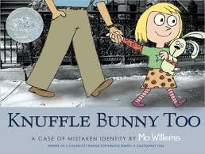
Teach your child to think critically:
Could this story be true?
Do you like this character? Why/ why not?
Does the character have a problem?
Has anything like this ever happened to you?
What would you do to solve a problem like this?

Slide 12
Think Aloud As You Read Nonfiction
Before reading, talk about what you and your child already know about the topic.
Take the time to look at the pictures, maps, graphs, read the captions and headings.
Stop and retell the facts you learn or find interesting.
Find ways for your child to share what he/she learns from reading.

Slide 13
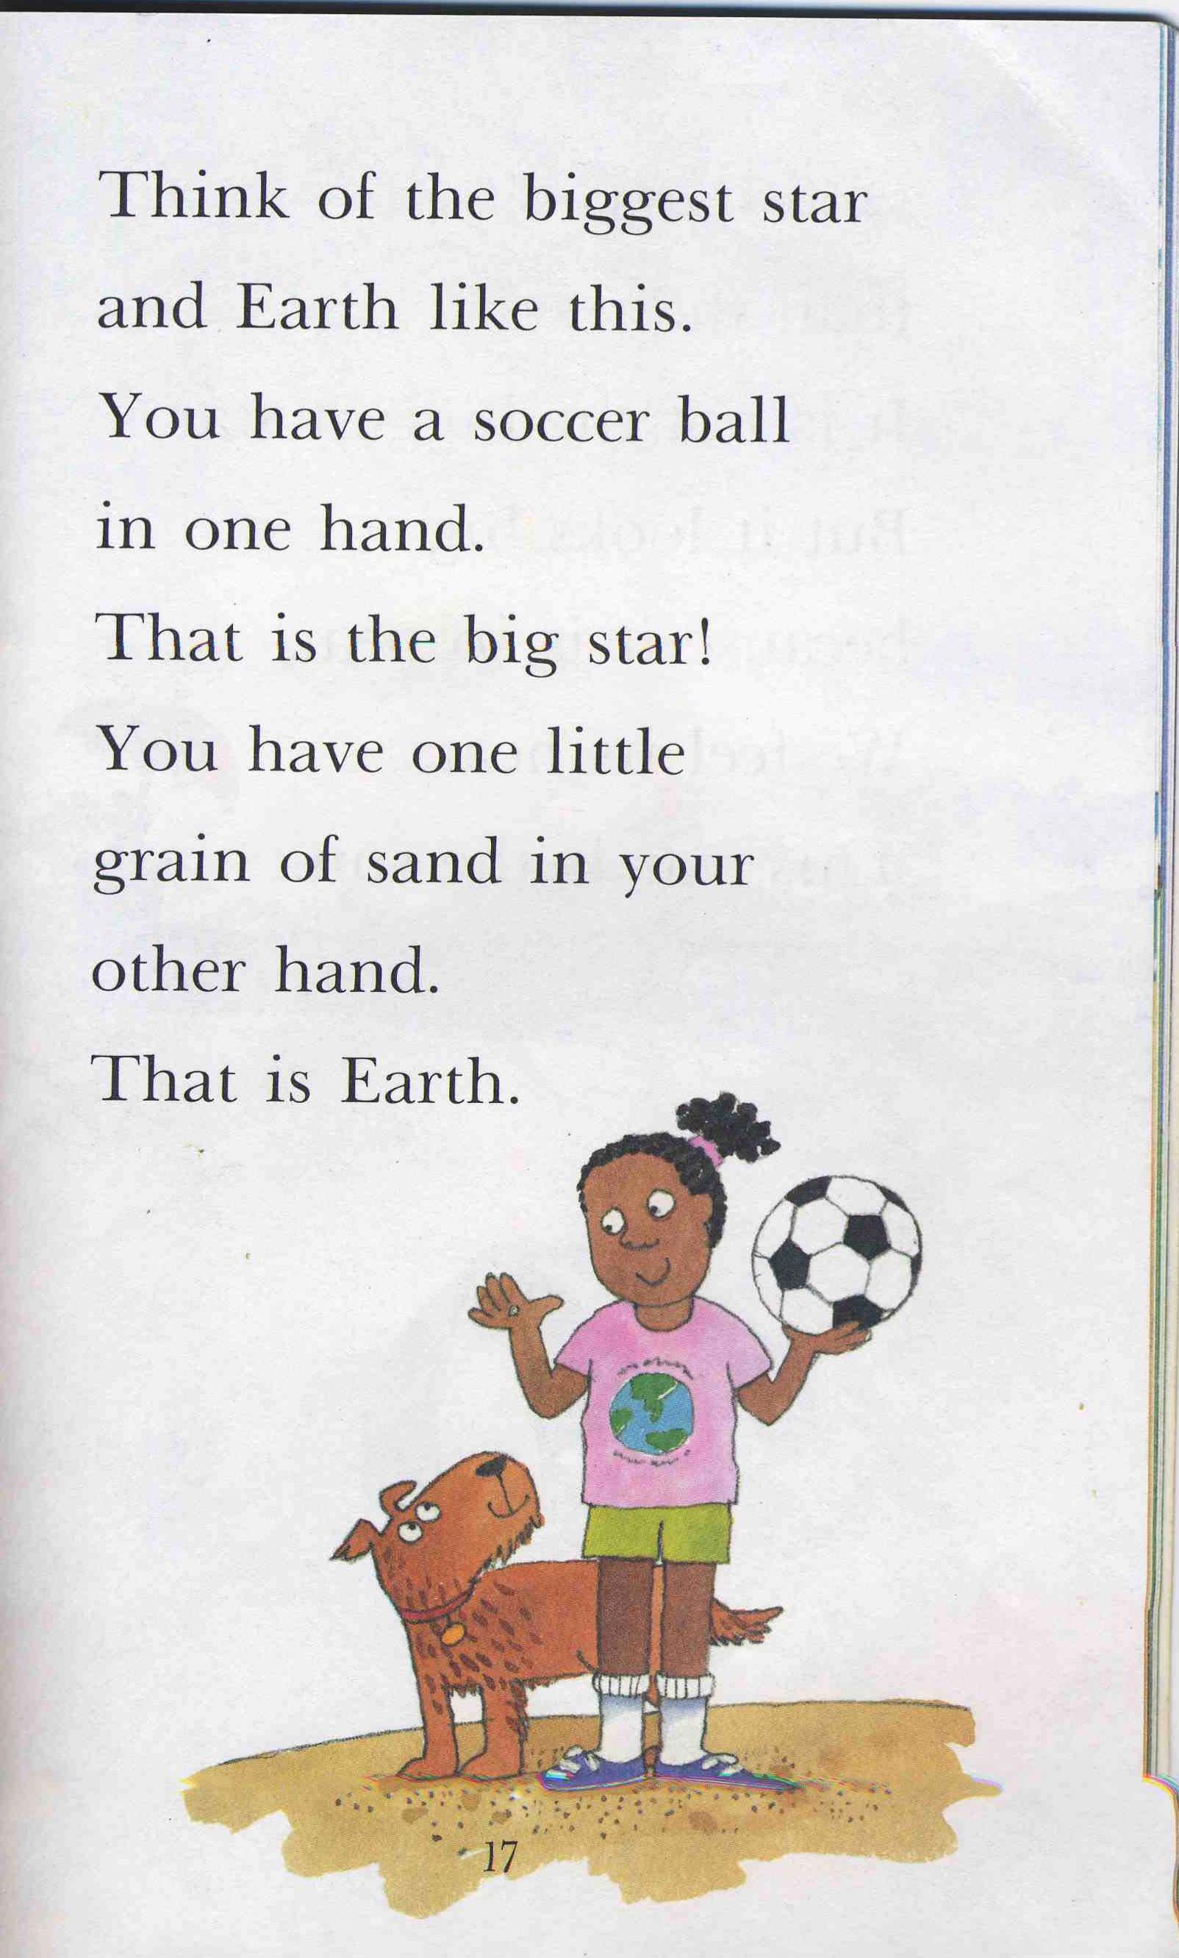
Slow down, act it out, use a benchmark, connect to what you already know.

Slide 14
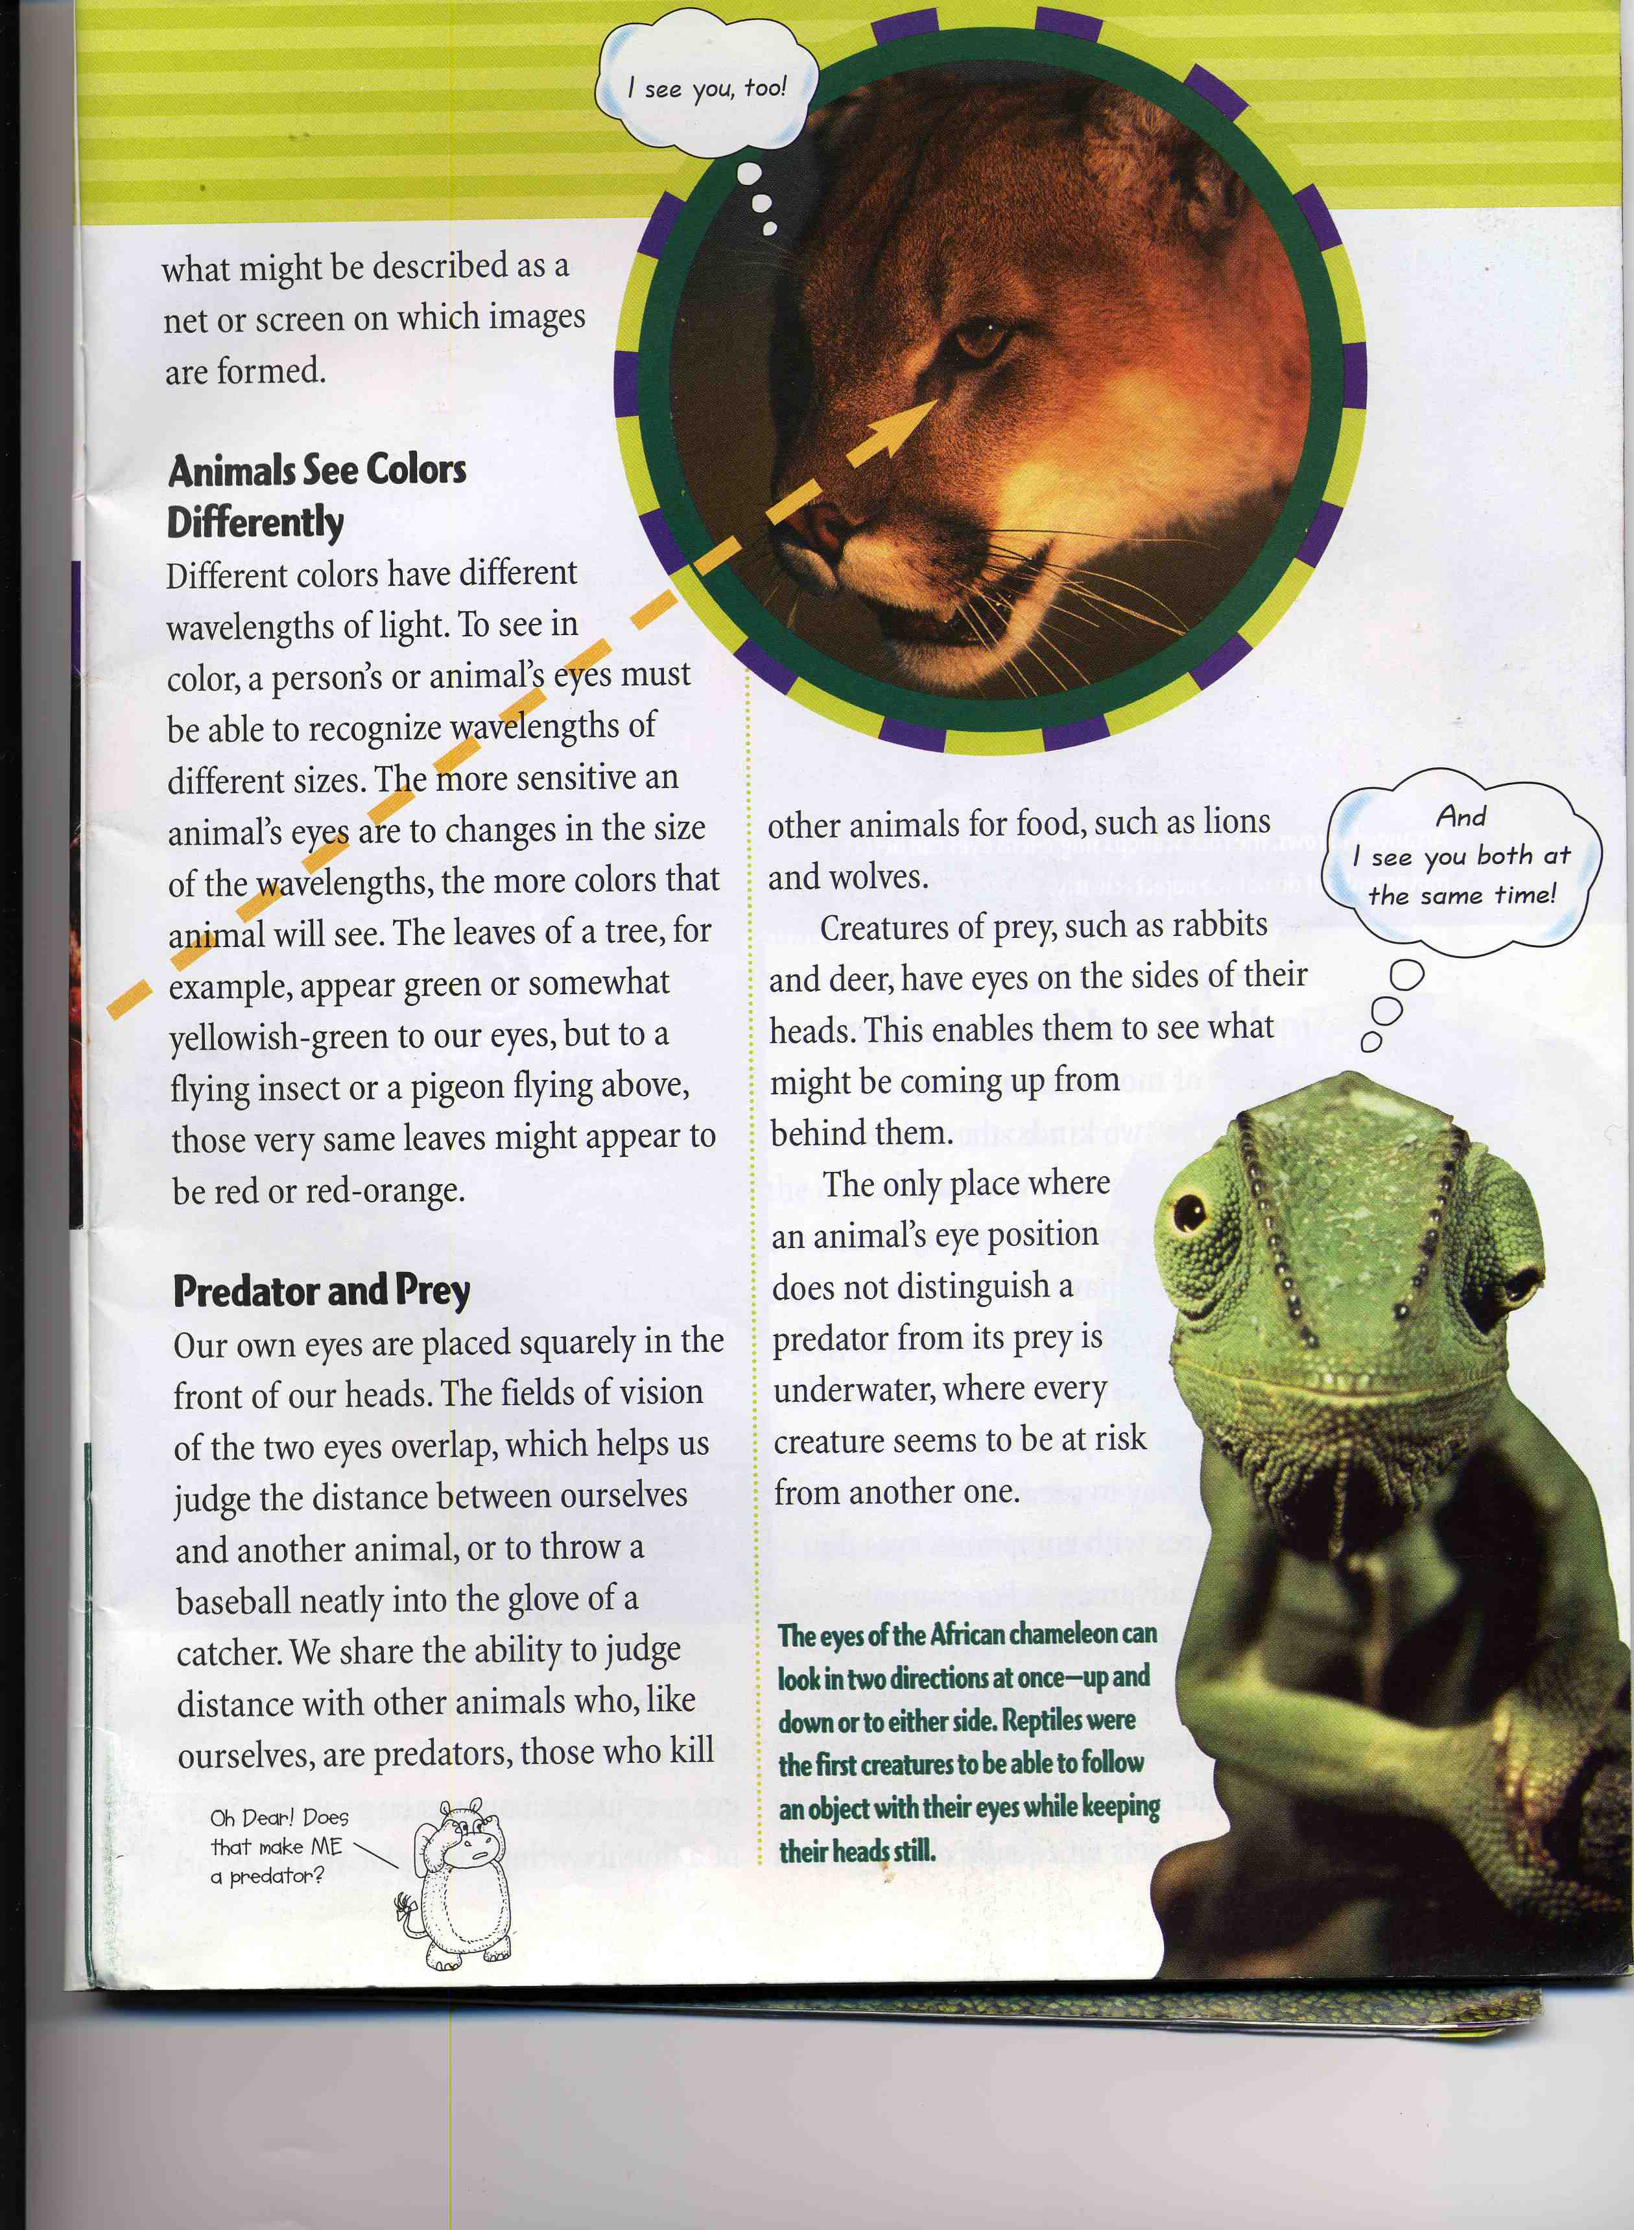
Use the headings to wonder and predict what you will learn as you read each section. This sets a purpose for reading.

Slide 15
Tips for Parents:
Be patient. It takes time to cultivate the art of listening.
Read picture books. Include nonfiction, (inc. biography) classics, nursery rhymes and poetry.
Choose books about topics your child finds interesting.
Be comfortable. Take your time.
Ham it up- change your voice, slow
down at important parts

Slide 16
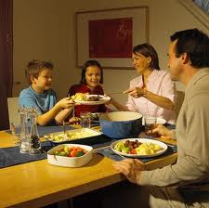
Final Thoughts
It is possible for young readers to read smoothly, quickly, and not comprehend a word. Reading aloud to children allows you to model the important focus on meaning.
Readers need to feel competent, trusted, part of the “Literacy Club.” Talk with your child about books. Avoid quizzing.
It is important to limit screen time.
Reading to your child develops their reading skills.

Slide 17
“You may have tangible wealth untold:
Caskets of jewels and coffers of gold.
Richer than I you can never be---
I had a mother who read to me.”
“The Reading Mother”
by Strickland Gillilan
from the Best Loved Poems
of the American People, 1936

